Slide 1
IMAGE PICKER
246
B611093 서영희
B611150 이석준

Slide 2
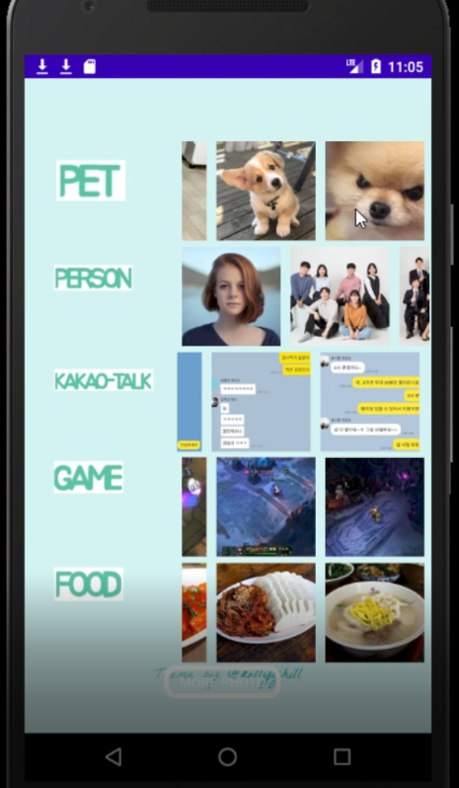
What is Image Picker?
Classify images in the album by “category”.
Make easy to find the image that you want.

Slide 3


PRoCESS
model
App
I've built CNN model.
And then We built ResNet18 model.
We made Android app called Image Picker.
Idea
Data
Accuracy
I found that It's hard to find specific photo in my album.
ex) Kakaotalk image
My teammate found Thousands of data argumentation was applied.
After we made App, We tried to solve our weakness of model.

Slide 4
How does It work?
Select Photo
Recyler view
Select Photo
Click button
Click more
photos
Classifier
Classifier

Slide 5
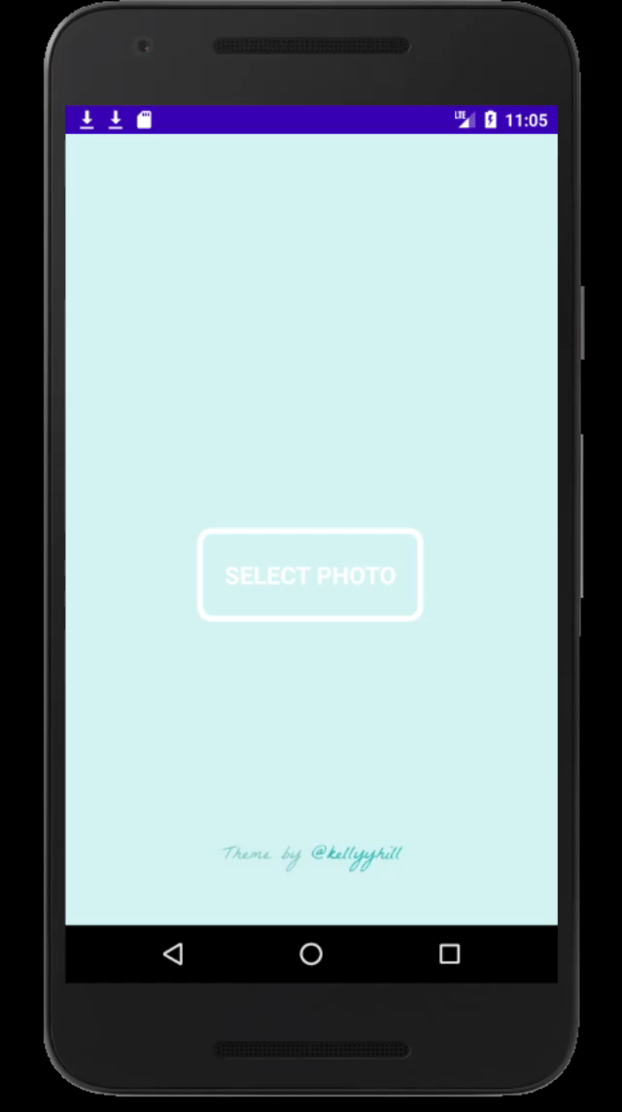

Slide 6
My work
Deap learning
resnet
I studied deap learning architecture, python, tensorflow
Saturn is a gas giant with a radius of nine times the Earth's Moon
First semester
APP
Train model
I made recyclerview using multiadapter and separated photos to each directory.
It took a long time to train model. It was hard work to increase accuracy
Second semester

Slide 7
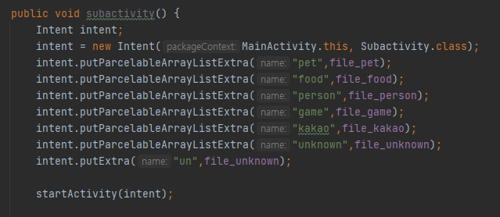
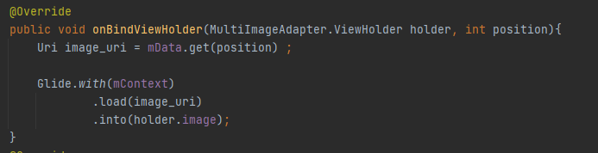

Slide 8
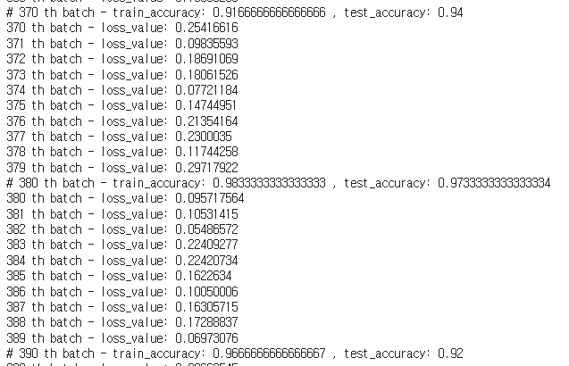
Process of training

Slide 9
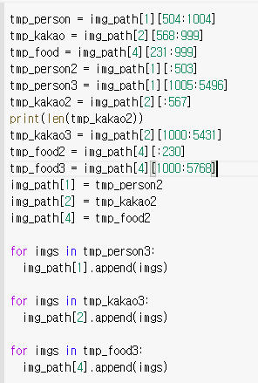
Making imageset without unappropriate data

Slide 10
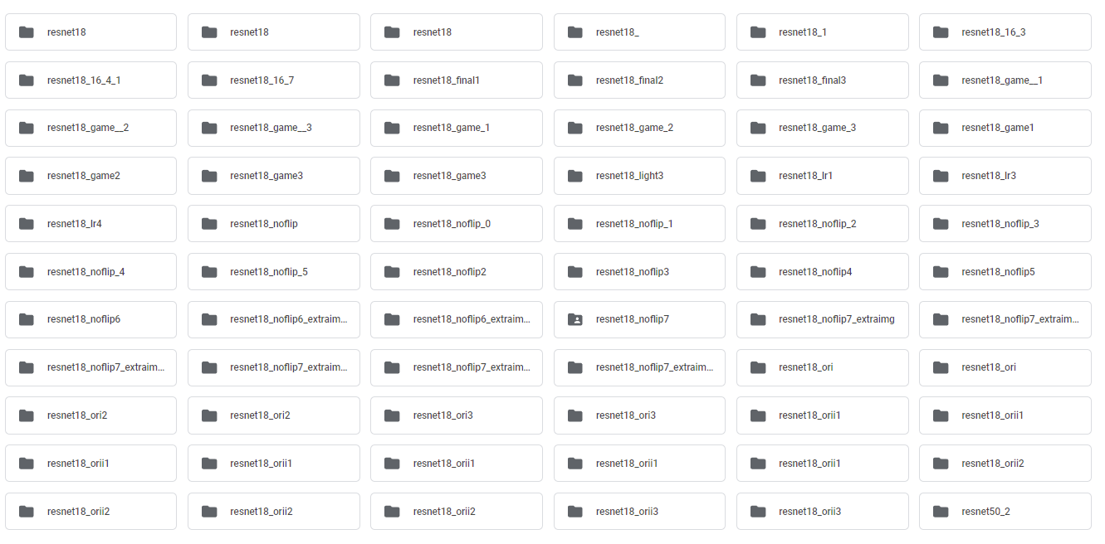

Slide 11
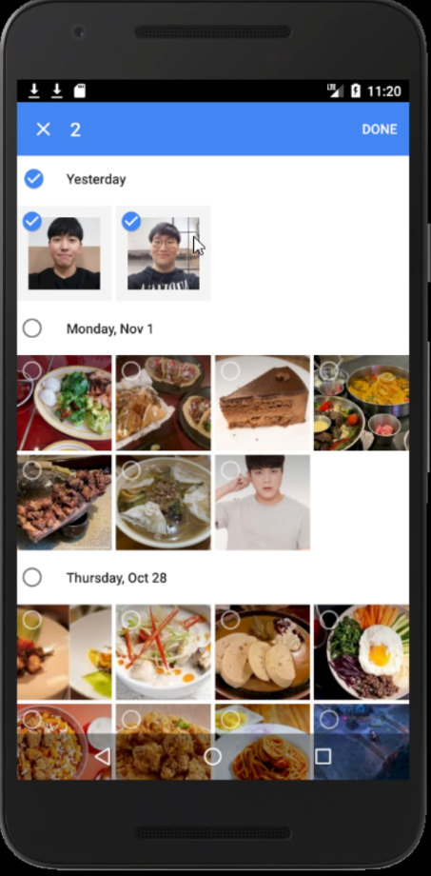
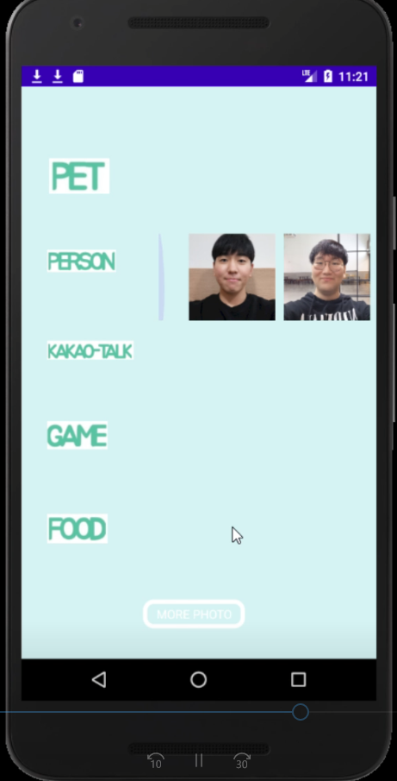

Slide 12
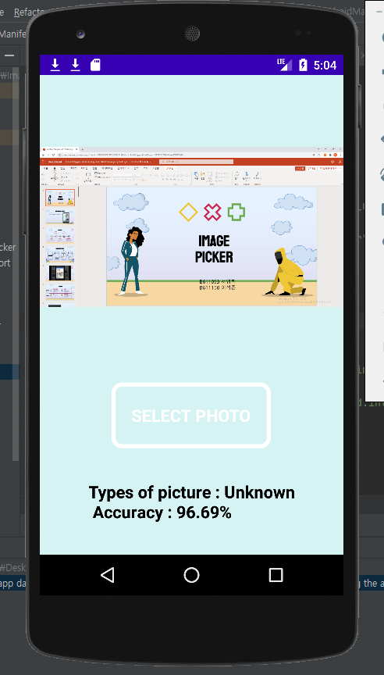

Slide 13
Thank you

